Slide 1
HUMAN RELATION APPROACH & HAWTHORNE EXPERIMENT (Neo-Classical Theory)

Slide 2
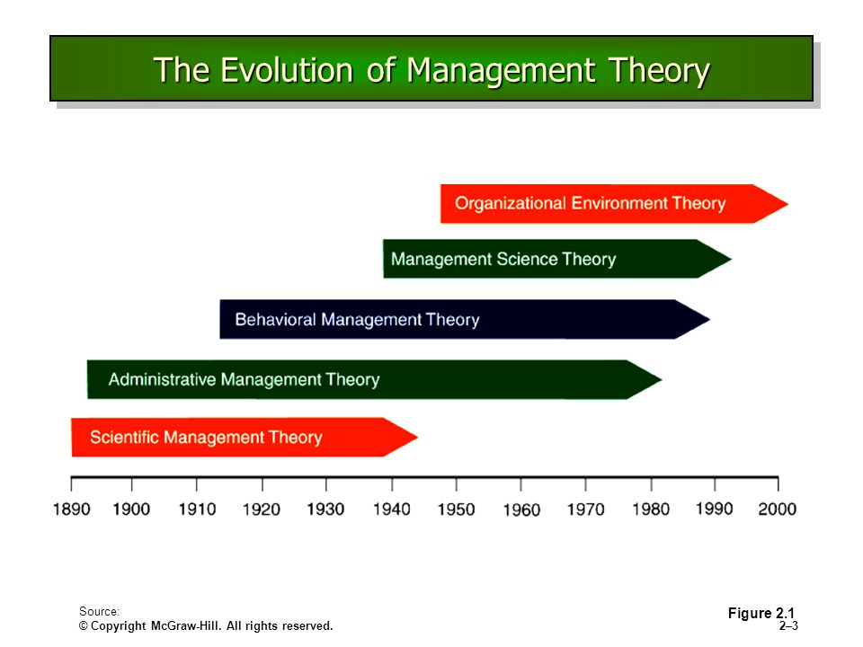

Slide 3
Evolution of Management
THE CLASSICAL THEORY OF MANAGEMENT
Scientific Management Theory
Administrative Management Theory
THE NEO-CLASSICAL THEORY OF MANAGEMENT
Human Relation Approach
Behavioral Approach
THE MODERN THEORY OF MANAGEMENT
Quantitative Approach
Systematic Approach
Contingency Approach to Mnangement

Slide 4
Neo-Classical Theory
Neo classical theory emerged since the classical approach did not achieve sufficient production efficiency and workplace harmony
Thus there was more interest in helping the managers to deal more effectively with people side of their organization
Emphasized understanding human behavior, needs and attitudes in the workplace
The focus is on “People” who staff for and manage the organization rather than just the Organization as an Entity

Slide 5
Human Relation Movement
An effort to make managers more sensitive to their employees needs
Arose out the influences of
the threat of unionization
the Hawthorne studies
the philosophy of industrial humanism
Emphasized satisfaction of employees, basic needs as the key to increase worker productivity

Slide 6
Human Relation Movement
The credit for the development of Human Relation Approach is given to Elton Mayo
Other individuals who contributed to Human Relation Approach are Maslow and Mc Gregor

Slide 7
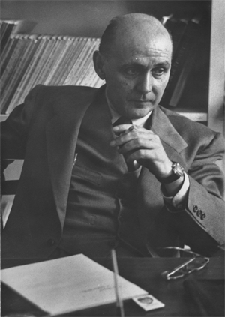
Elton Mayo & Hawthorne Experiment
Associate professor In Industrial Research at Harvard University
Founder of Industrial sociology and the “Human Relation Movement”
But the first intensive and systematic analysis of human factor in organization was made in the form of Hawthorne Experiments

Slide 8
Hawthorne Experiment
Conducted by Elton Mayo and Fritz Roethlisberger in the 1920s with the workers at the Hawthorne plant of Western Electric Company
It employed about 30,000 employees at the time of Experiments
Although company provided benefits like pension, sickness benefits & other recreational benefits, there was a great deal of dissatisfaction among the workers and productivity was not up to the mark

Slide 9
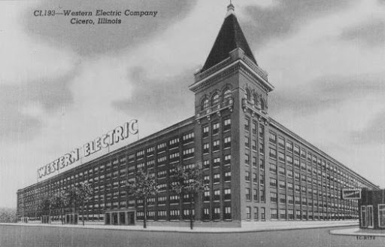
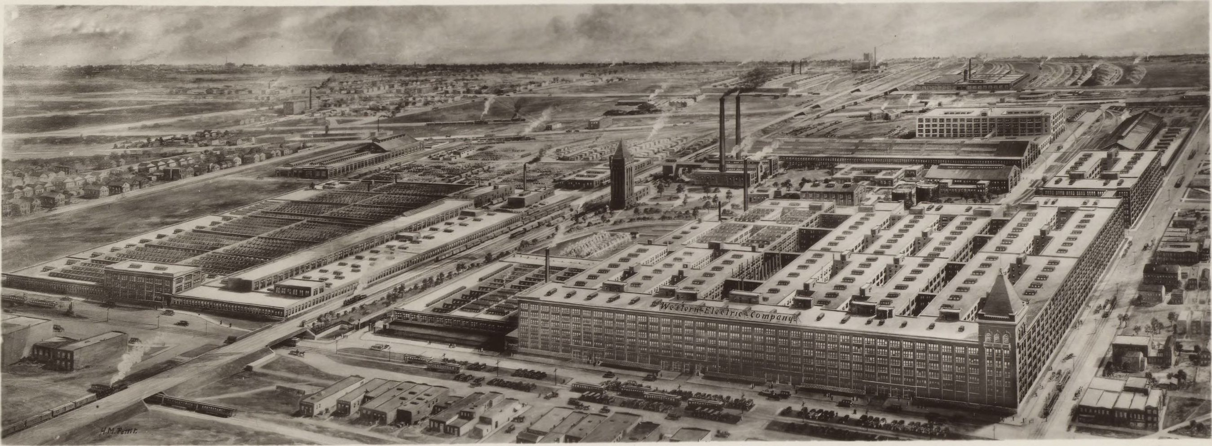
Western Electric Company outside Chicago

Slide 10
Hawthorne Experiment
Illumination study (1924- 27)
Relay Assembly Test Room (1927-29)
Interviewing Program (1928-30)
Bank wiring room observation study (1932)

Slide 11
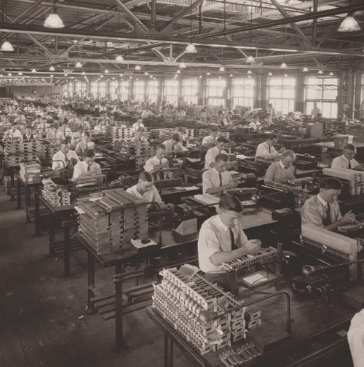
Illumination Experiment
Workers producing Telephone Exchange bills

Slide 12
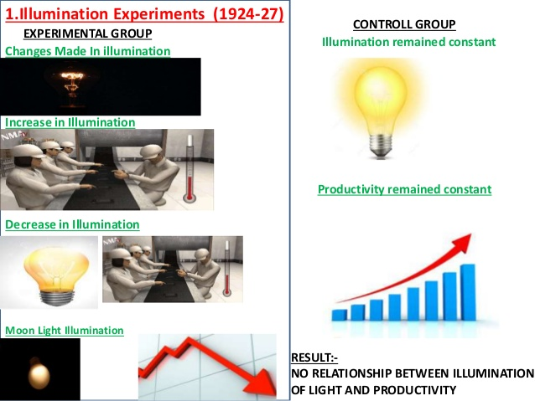
Illumination Experiments

Slide 13
Illumination Experiments
Elton Mayo and his team found that as they increased the illumination in the experimental group, both groups increased production
when the intensity of illumination was decreased, the production continued to increase in both the groups
the production in experimental group decreased only when the illumination was decreased to the level of Moonlight
Thus, it was concluded that illumination did not have any effect on productivity

Slide 14
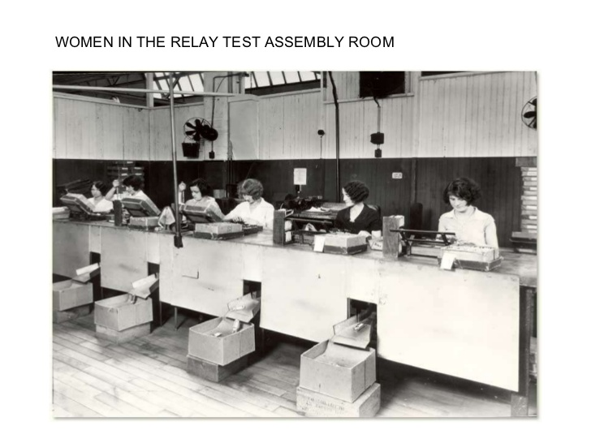
Relay Assembly Test Room Experiments
Relay Assembly Test Room where 6 Women were selected for the Experiment

Slide 15
Relay Assembly Test Room Experiments
1st Change :
Incentive system was changed
They observed that the productivity increased
2nd Change :
Five minutes rests – one in morning session and other in evening session were introduced
it was later increased to 10 minutes
They observed that productivity increased

Slide 16


Relay Assembly Test Room Experiments
3rd Change :
The rest period was reduced to 5 min but frequency was increased
The productivity was decreased slightly
The girls complained that frequent rest intervals affected the rhythm of work

Slide 17

Relay Assembly Test Room Experiments
4th Change :
Number of rest was reduced to two of 10 min each
but in the morning coffee or soup was served with sandwich
in the evening snacks was provided
productivity increased

Slide 18

Relay Assembly Test Room Experiments
5th Change :
Changes in working hours and workday were introduced
like eliminating Saturday work
Allowing women to leave one hour early from 5.00 p.m. to 4.00 p.m.
Productivity increased

Slide 19
Relay Assembly Test Room Experiments
As each change was introduced, absenteeism decreased, morale increased and less supervision was required
Now, the researchers decided to revert back to original position, that is no rest and no benefits
Surprisingly, productivity increased further instead of decreasing
Concluded that productivity increased not because of positive changes in physical factors but because of a change in the girls attitude towards work and their work group
Developed a feeling of stability and sense of belongingness
Developed a sense of responsibility and self discipline

Slide 20




Mass Interviewing Programme
Reason for conducting : To study the human behavior in the company
No. of interview conducted : with 20,000 employees
To determine employees attitude towards company, supervision, promotion & wages
Direct Interviewing
Non-Directive Interviewing

Slide 21
Mass Interviewing Programme
Interview program gave valuable insights about human behavior like
Worker’s behavior was influenced by group behavior
Social demand of a worker are influenced by social experience in groups both inside and outside the work plant

Slide 22

Bank Wiring Observation Room Experiment
14 male workers were selected and they were engaged in the assembly of terminal banks for the use in telephone exchange
More Productive group gets Bonus

Slide 23
Bank Wiring Observation Room Experiment
Conducted to analyze the functioning of small groups and how it affects the individual behavior
Assumption was that in order to earn more, workers would produce more
Also to get the group bonus, they would help each other to produce more
However, this assumption did not hold valid
Workers decided the target for themselves which was lower than the company target
This study suggested that informal relationships are an important factor in determining the human behavior

Slide 24
Bank Wiring Observation Room Experiment
Workers gave restricted output due to following reasons:
Fear of Unemployment
Fear of raising standard
Protection of slower worker
Satisfaction on the part of Management

Slide 25
Characteristics of Human Relation Approach
Organization is a social system
System is composed of many interacting groups
Many informal groups emerge at workplace
They have great impact on the behavior of members
Workers not always behave rationally
Monetary gains alone cannot motivate workers
Workers participation in decision making boosts morale and productivity

Slide 26
Behavioral Science Approach
Contributors
Abraham Maslow
Mc Gregor
Chester Bernard

Slide 27
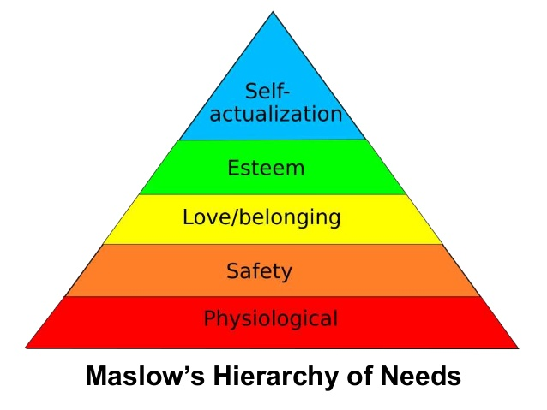
Abraham Maslow’s Hierarchy of Needs

Slide 28
Theory X & Theory Y
Douglas McGregor (1906-1964)
THEORY X | THEORY Y
The average human being dislikes and avoid work | Do not dislike work
Must be controlled, directed or threatened with punishment | Self direction and self control
Prefer direction, avoid responsibility, has little ambition want security | Seek responsibility
 | Imagination, creativity widely distributed
 | Intellectual potential only partially utilized

Slide 29
The Emergence of Communication
Chester Bernard
Considered a bridge between classical and human relation theories
Strict lines of communication – classical theory
A “human based system of organization”

Slide 30
Six Issues Relevant to organizational communication
Formal & Informal Communication
Cooperation
Communication
Incentives
Authority
Zone of Indifference

Slide 31
Conclusion
People are the key to productivity
Success depends on motivated and skilled individuals committed to the organization
Managerial sensitivity to employees is necessary to faster the cooperation needed for higher productivity

